Slide 1


University of Basrah Al-zahra college of medicine
Ministry of higher Education and Scientific Research
Academic year 2025-2026
1st year. Semester S1
Foundation of Medicine
Lecture: 1 Session: 1 Date: 23/November/2025
Assisted prof.
Dr. Mazin Abed Hazza

Slide 2
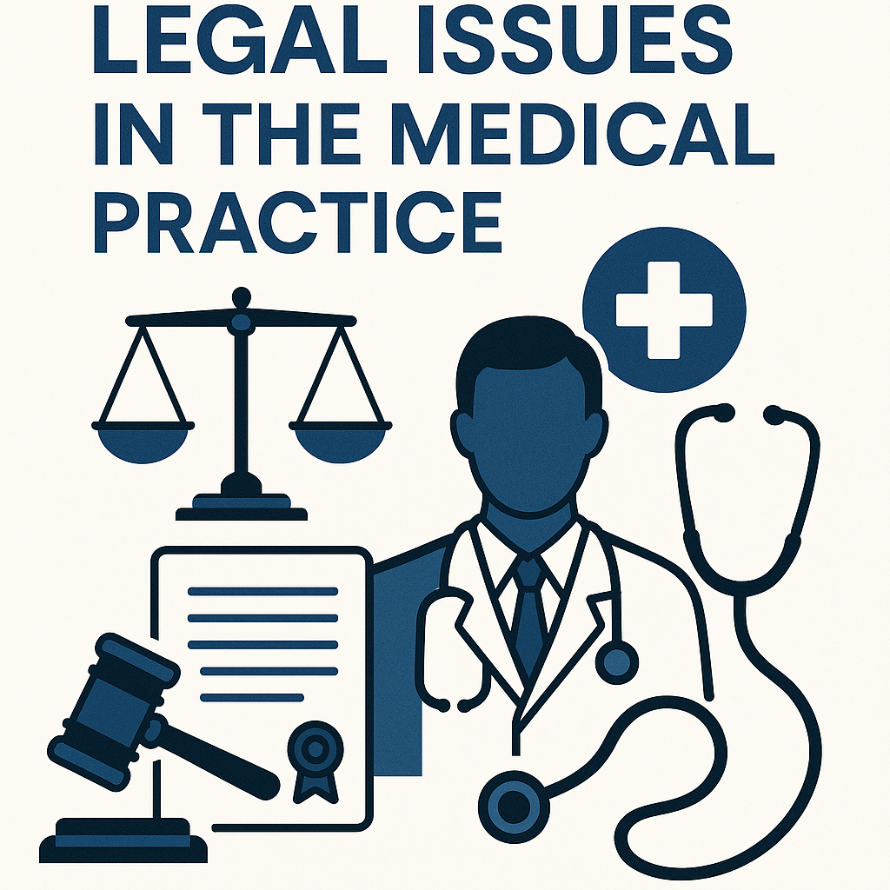
Legal issues in the Medical practice
Assisted prof.
Dr Mazin abed Hazza
MD, DM (Baghdad university), FICMS, CABM, FICMS- cardiology

Slide 3

Objective
To knew the essential legal issues in the medical practice

Slide 4
5 legal issues
Consent
Duty of care
Negligence.
Confedentiality
Treating the patint with respect.

Slide 5

1. Consent
The patient agreement to the medical procedure after receiving full and clear explanation about the procedure

Slide 6
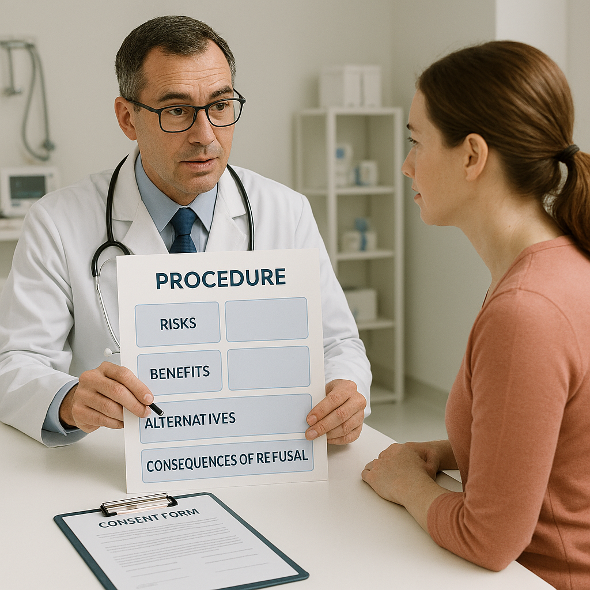
What are the points that the pateint should knew about the procedure?
Its risk.
Its benefits.
Available alternatives.
What may happen if the pateint refuses.
The Dr. should not perform any examination and treatment without pateint’s consent.
Except in the emergencies

Slide 7
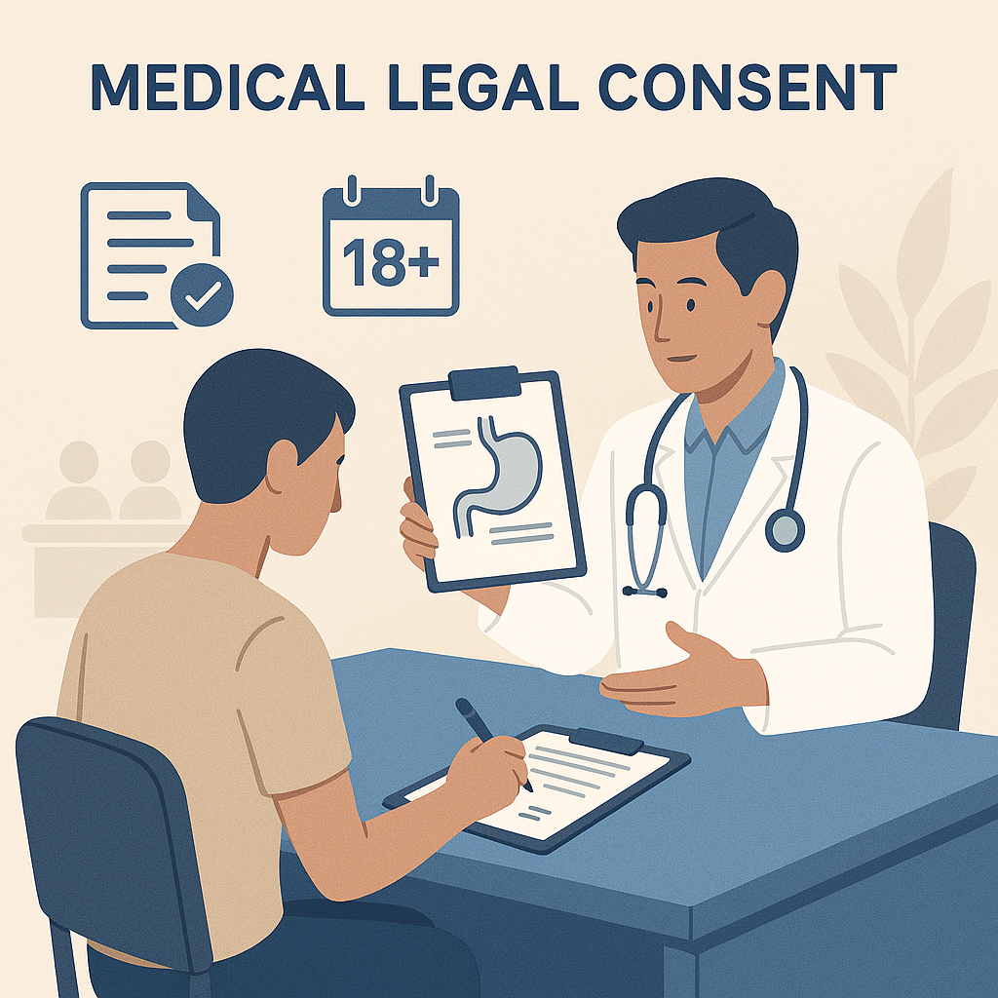
Whome is the legal consents
The pateint himself if he is > 18 year old.
1st degree relative.
Medical commity.

Slide 8
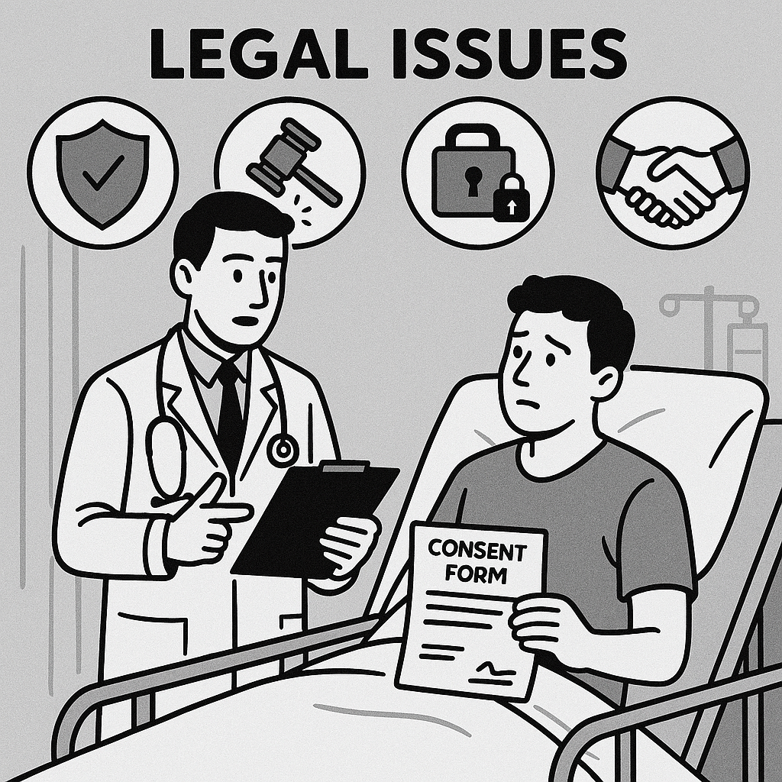
examples
Surgery without consents. (e.g. you tell the pateint that it is simple surgery and donot explain the possible complications, and do not give him other alternative.
Internal examination like rectal or vaginal examination without cosent.
Changing the procedure during the surgery.
Giving high risk medications without worning.

Slide 9
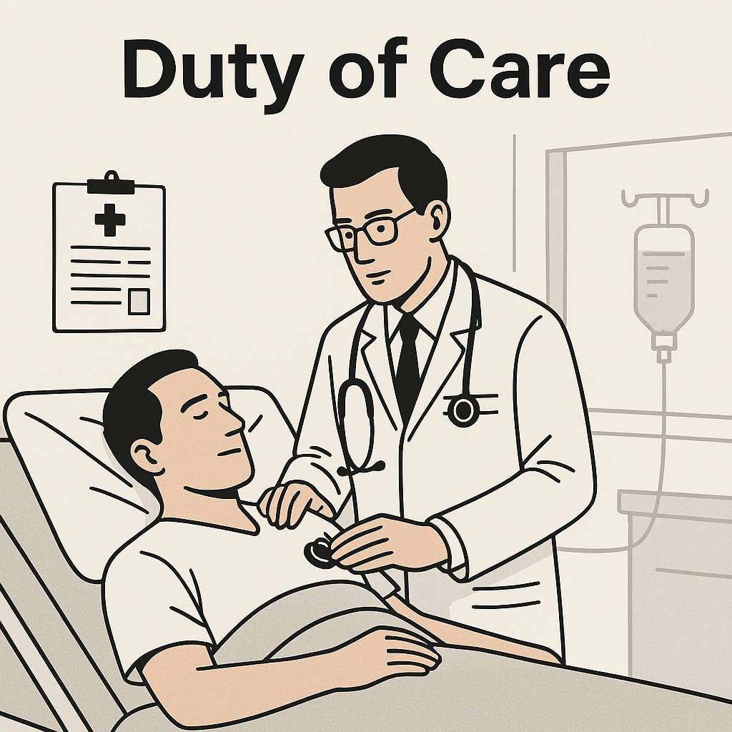
2. Duty of care
After the pateint’ s consent the Dr. is legally and ethically required to act carefully, and professionally and to avoid any action or negligence that might harm the patient.
Once the Dr. accept the patein, he become legally responsible for the pateint.

Slide 10

Examples
Chest pain, no ECG was done for the pateint.
Give the pateint medication despite known allergy.
No postoperative monitoring.
Leaving surgical instrument inside the pateint.
Not following the lab results.
Incorrect medication dose.
Ignoring red flag symptoms like headache and vimiting.
Nt maiting sterile technique

Slide 11
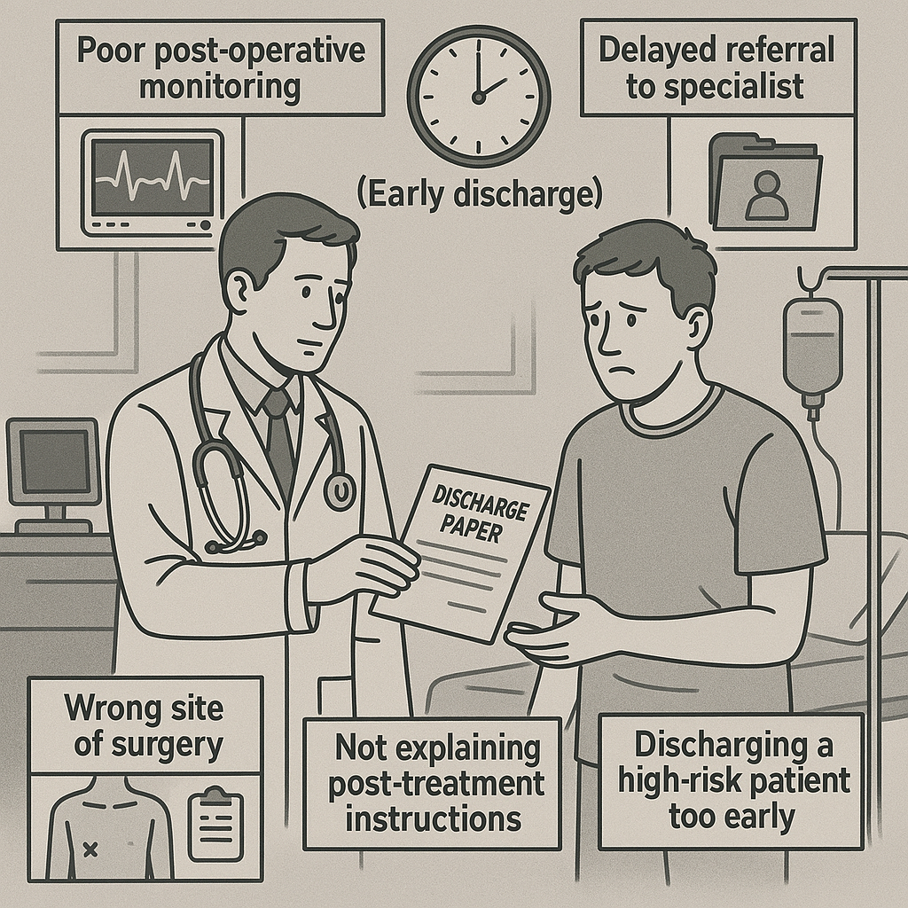
Examples
Poor post-operative monitoring.
Delayed refferal to the specielest.
Wrong site of surgery.
Not explaining post-tratment instructions.
Discharge a high risk patient too early.

Slide 12
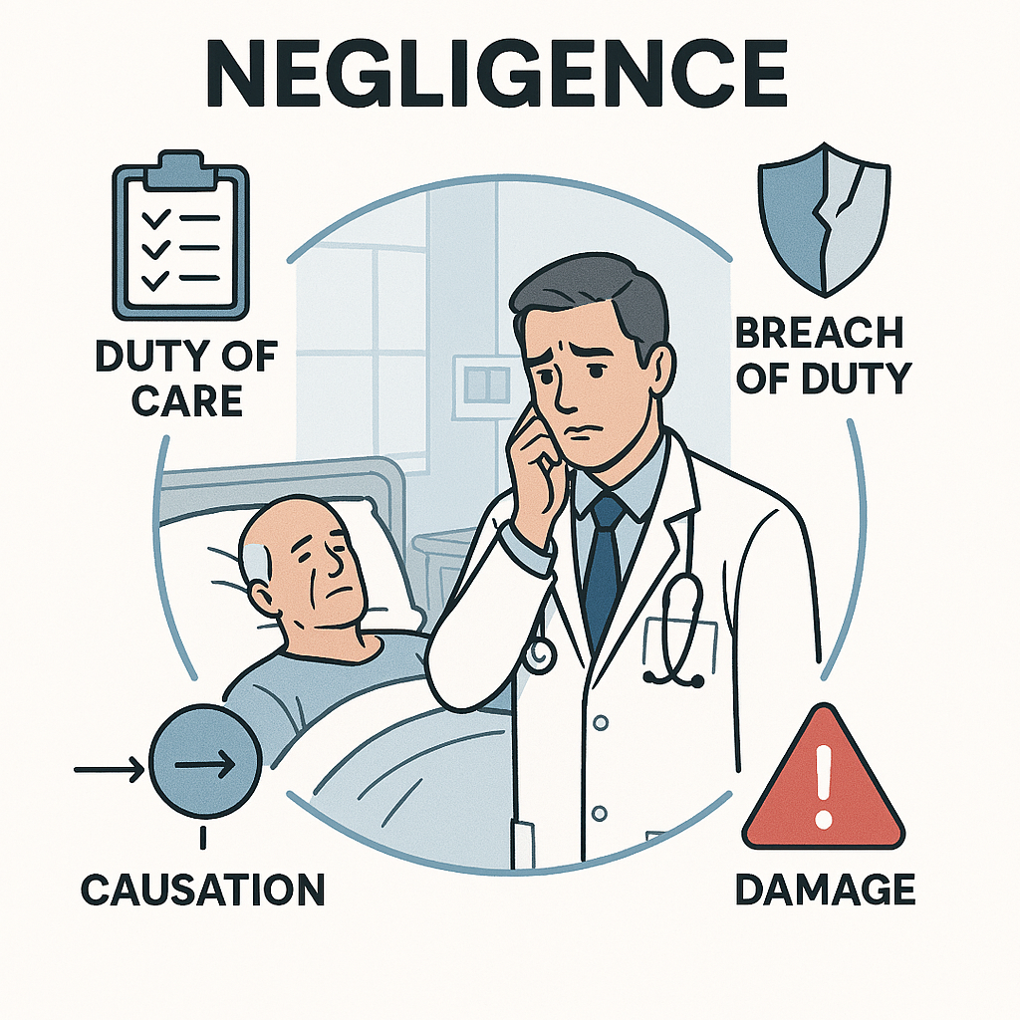
3. Negligence
Failure of the Dr. to deliver the expected standard of care resulting in harm of the patient.
4 legal elements of medical negligence:
1. duty of care.
2. Breach of duty (Dr. failed to meet the standard of care)
3. causation( breach of duty directly cause harm)
4. Damage(actual harm occurred, physical, psychological and financial)

Slide 13
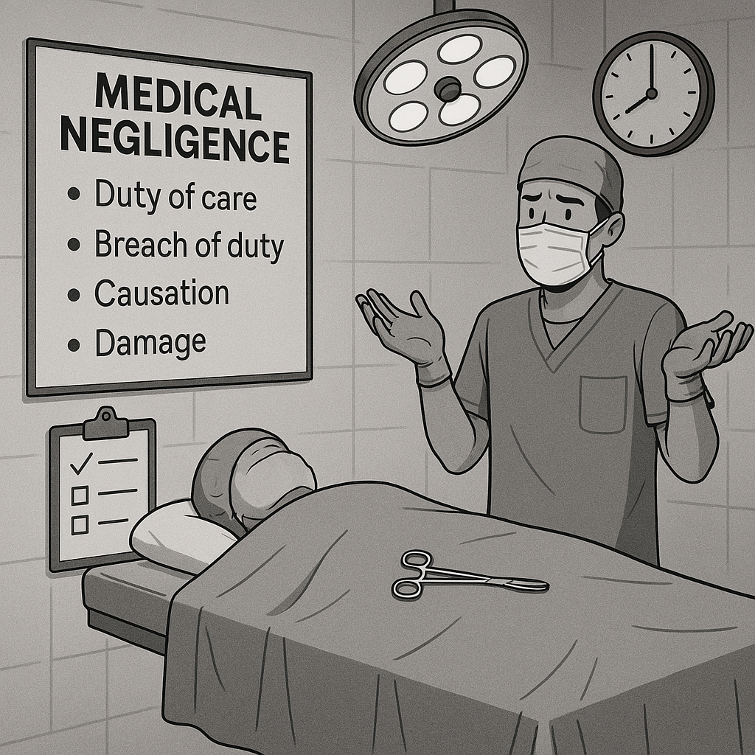
Examples
Failure to perform necessory test == misdiagnosis.
Perform procedure on wrong body part.
Delayed providing medical intervention, making worsening of the condition

Slide 14

4. Confidentiality
Legal and ethical obligation of the Dr. not to disclose a pateint’ personal or medical information to anyone who is not authorized, unless the patient give permission or the law allows that in specific situation.

Slide 15
What are the information that should not be shared?
Medical history
Test results
Diagnosis.
Treatment plan
Any sensitive personal plan

Slide 16
When you can legally discloed patient’s informations?
When there is risk of patient life.
A court order requiring disclosure.
Sharing the informations with the health team.
When the patient gives explicit consent

Slide 17

5. Treating the patient with respect.
You have to respect:
Dignity كرامته
Privacy.
Autonomy استقلاليته
Non-discrimination
Respectful communication

Slide 18

ابلغ الكلام
الناس صنفان:
اما اخ لك في الدين
او نظير لك في الخلق

